Slide 1
A Provider-side View of Web Search Response Time

Slide 2
Web services are the dominant way to find and access information
Notes:
*show hands* how many people use web services such as search and social networks? – web service is important to us, it is a service heavily used by almost every one, for search, online shopping, and social interactions. Even a small increase in response time can hurt our experience.

Slide 3
Web service latency is critical to service providers as well
Latency
+0.5 sec
revenue
-20%
Google
Bing
Latency
+2 sec
revenue
-4.3%
Notes:
The latency of web services is critical to the users like you and me. But it is just as important to the service providers because their ability to monetize the service depends on its performance. There are two recent studies show that a half second increase in search response time leads to 20% drop of Google revenue. A 2 seconds increase in search response time leads to 4.3% of Bing revenue.

Slide 4
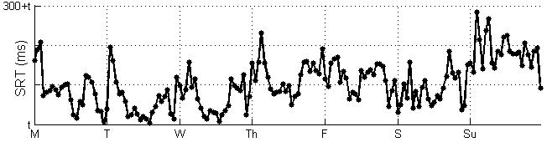
Understanding SRT behavior is challenging
300+t
SRT (ms)
t
M
T
W
Th
F
S
Su
200+t
SRT (ms)
t
peak
off-peak
Notes:
*This behavior is not unique to this particular provider, but we have confirmed that it occurs for another large provider as well.*
While response time is important, we find that it is incredibly hard to understand.
This graph is the SRT (search response time) over a one-week duration for one of the largest search providers in the world. X-axis is the day of week. Y-axis is the SRT. Each data point is one hour average of SRT. We see that it varies widely and inexplicably over time, despite being averaged over one hour and many, many users.
It not only varies, but it can also vary counter-intuitively.
<click>
This graph shows the average SRT during peak hours and offpeak hours and during weekdays and weekends as highlighted in shaded area in the first graph.. SRT is much higher during off-peak hours and weekends!
As we show in the paper, this is despite the fact that the load on the search service is much lower during off peak hours.
Thus, we find this surprising behavior that performance is poorer when the load is lower.

Slide 5
Our work
Explaining systemic SRT variation
Identify SRT anomalies
Root cause localization
Notes:
Our work is motivated by such behaviors in SRT.
It consists of three main parts.
First, we explain the systemic SRT variation, which is the periodic, almost-predictable changes in SRT. I will describe why those changes occur.
Second, we find that because of these changes, finding anomalies in SRT is hard because real anomalies get masked by systemic changes. I will describe a method that can effectively identify anomalies by factoring out the interference from systemic variations.
Third part is about root cause localization of anomalous SRT. Due to time limitation, I will skip this part of the work in this talk.

Slide 6
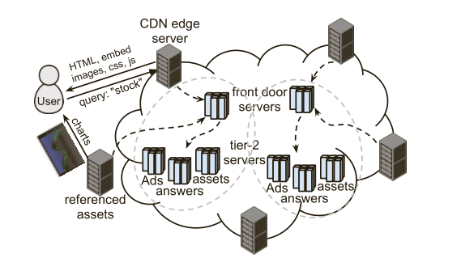
Infrastructure of a large Web service
Data centers
tier-1 server
tier-2 servers
CDN
Notes:
To understand the primary factors, we apply analysis of variance (anova) on our collected time intervals. ANOVA is a statistical tool that partitions SRT variation into components attributable to each time interval variable. It works as follows (***replace with new graph, combine this graph with the previous graph)
The results show that the top 2 time intervals that contribute most of the SRT variation are T_net and T_BOP. They are affected by network characteristics, query type, and browser speed, respectively. On the other hand, the time intervals that are mainly affected by server processing time are less important.
Therefore, our conclusion of this study is that the primary factors in SRT variation are network, query, and browser, while server processing time is less important.
In the next few slides, we will look at each of the three primary factors by controlling the other two factors.

Slide 7















Client- and server-side instrumentation
query
$$T_{fs}$$
$$T_{fc}$$
HTML header
$$T_{sc}$$
$$T_{head}$$
Brand header
$$T_{brand}$$
$$T_{intchk1}$$
Query results
$$T_{tc}$$
$$T_{resHTML}$$
BoP scripts
$$T_{BOP}$$
$$T_{intchk2}$$
Embedded images
$$T_{embed}$$
Referenced content
$$T_{ref}$$
$$T_{script}$$
on-load
Notes:
Before digging into the details of our work, let me briefly describe how search works and the data we use to analyze its behavior.
A query works as the following. After the server receives the query request from a user, it sends the response page in three chunks. The first chunk includes the HTML and brand header. Second chunk contains the 10 plain text search results and some javascripts that will be run at the bottom of pages. Images will be sent in the third chunk. Some images are embedded in the response page. Other images, as well as some CSS and javascript will be sent as separate referenced content. They are fetched by browsers by issuing additional queries to the search provider or third parties server. These queries are pipelined and issued in parallel to the reception and parsing of HTML content.
After user receives all three chunks, it will send a post load request to the server for a 1x1 image. This is mainly used by the search provider to estimate the SRT from Provider’s perspective, as they can not log the first timestamp when user triggers the search query on the user side.
For each of the event discussed here, we collect detailed time intervals using javascript and server-side instrumentation that captures each of the events. We also use the sum of the two shaded area to estimate the network round trip time.

Slide 8












Impact Factors of SRT
server
network
browser
query
$$T_{brand}$$
$$T_{net}$$
$$T_{head}$$
$$T_{tc}$$
$$T_{fs}$$
$$T_{BOP}$$
$$T_{ref}$$
$$T_{script}$$
$$T_{resHTML}$$
$$T_{embed}$$
$$T_{fc}$$
$$T_{intchk1}$$
$$T_{intchk2}$$
$$T_{sc}$$
Notes:
*explain the four factors*
With these time intervals at hand, how can we explain the SRT variation puzzle as we discuss in the beginning of this talk?
First, we group all possible impact factors of SRT into four categories, server, network, browser, and query. They should capture most of the events that may impact the end-to-end performance between the user and server. However, unfortunately, the relationship between the time intervals and the impact factors are not one to one mapping. There is no single time intervals that capture each single impact factor we listed here.

Slide 9
Primary factors of SRT variation
Apply Analysis of Variance (ANOVA) on the time intervals
Notes:
To understand the primary factors, we apply analysis of variance (anova) on our collected time intervals. ANOVA is a statistical tool that partitions SRT variation into components attributable to each time interval variable. It works as follows (***replace with new graph, combine this graph with the previous graph)
The results show that the top 2 time intervals that contribute most of the SRT variation are T_net and T_BOP. They are affected by network characteristics, query type, and browser speed, respectively. On the other hand, the time intervals that are mainly affected by server processing time are less important.
Therefore, our conclusion of this study is that the primary factors in SRT variation are network, query, and browser, while server processing time is less important.
In the next few slides, we will look at each of the three primary factors by controlling the other two factors.

Slide 10









60
40
20
0
Explained variance (%)
$$T_{net}$$
$$T_{BOP}$$
$$T_{ref}$$
$$T_{script}$$
$$T_{resHTML}$$
$$T_{fc}$$
$$T_{head}$$
$$T_{sc}$$
$$T_{tc}$$
server
network
browser
query
Primary factors: network characteristics, browser speed, query type
Server-side processing time has a relatively small impact
Notes:
*our conclusion doesn’t mean that server processing time is not important, but just that it plays a less important role in SRT variation.*
In the next few slides, we will discuss each of the primary factors in detail while controlling the other two factors.

Slide 11
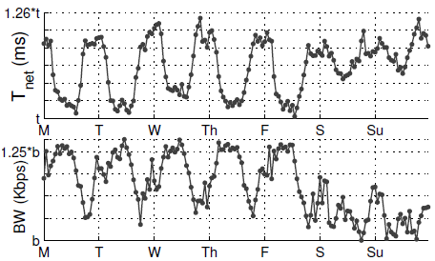
Variation in network characteristics
RTT
Notes:
$$\text{N}\text{etwork} \text{characteristics} \text{are} \text{worse} \text{by}\text{ 20\% }\text{during} \text{off}\text{−}\text{peak} \text{hours}$$

Slide 12
Explaining network variations
Residential networks send a higher fraction of queries during off-peak hours than peak hours
Residential networks are slower

Slide 13
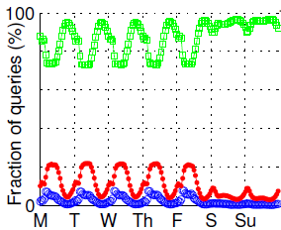
residential
enterprise
unknown
1.25t
25%
t
RTT (ms)
residential
enterprise
Residential networks are slower
Residential networks send a higher fraction of queries during off-peak hours than peak hours
Notes:
*Conservative classification of networks using weekend to weekday usage ratio
Worse network translates to worse SRT

Slide 14
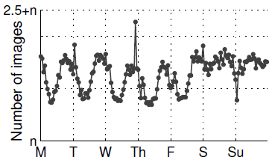
Variation in query type
Impact of query on SRT
Server processing time
Richness of response page
Measure: number of image
Notes:
What is query type?
Query type variation.
*Number of images correlate to other richness measures.

Slide 15



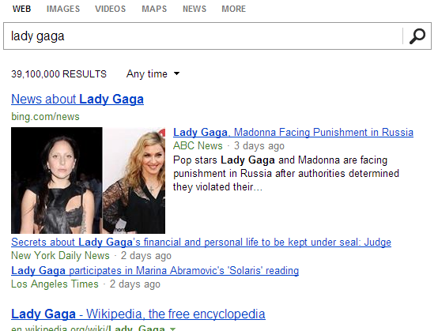
Explaining query type variation
Peak hours
Off-peak hours
Notes:
peak: work related, no images off-peak: leisure-oriented, rich queries
Richer queries leads to higher SRT

Slide 16
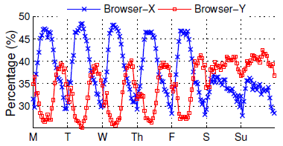
Browser variations
Two most popular browsers: X(35%), Y(40%)
Browser-Y sends a higher fraction of queries during off-peak hours
Browser-Y has better performance
Javascript exec time
1.82t
82%
t
Browser-X
Browser-Y

Slide 17
Summarizing systemic SRT variation
Server: Little impact
Network: Poorer during off-peak hours
Query: Richer during off-peak hours
Browser: Faster during off-peak hours
Notes:
*Net effect is ...

Slide 18
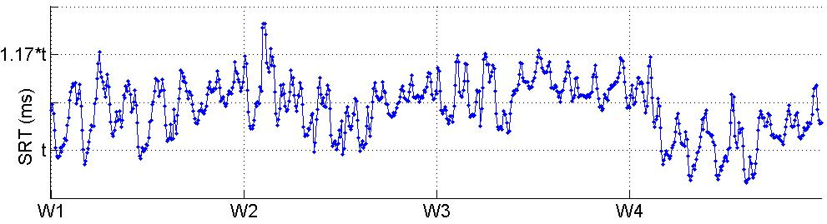
Detecting anomalous SRT variations
Challenge: interference from systemic variations
Notes:
*is this an anomaly?*

Slide 19
Week-over-Week (WoW) approach
$SRT=Long term trend$ + Seasonality + Noise
Notes:
*time series decomposition (*put a brief intro of WoW, summation of three components)
For noise component, our assumption: same hour across different weeks have similar performance
*168 models, as one model doesn’t work

Slide 20

Week-over-Week (WoW) approach
The long-term trend component
Can be computed as a centered moving average with the window size set to T:

Slide 21

Week-over-Week (WoW) approach
After removing the long-term trend:
The seasonal component
Can be computed as seasonal moving average:

Slide 22

Week-over-Week (WoW) approach
SRT at time t is anomalous if:

Slide 23
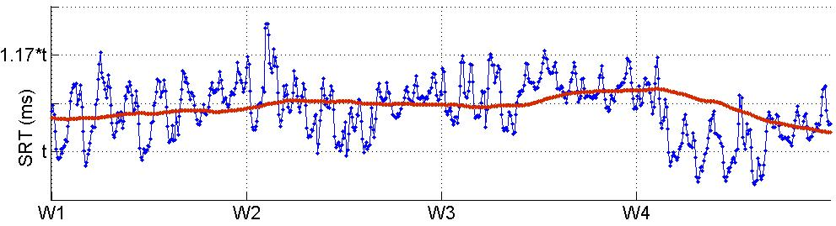
Notes:
*time series decomposition (*put a brief intro of WoW, summation of three components)
For noise component, our assumption: same hour across different weeks have similar performance
*168 models, as one model doesn’t work

Slide 24
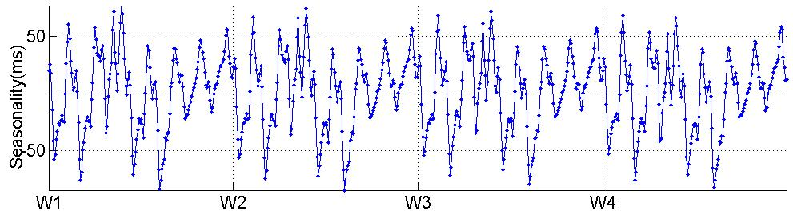

Slide 25
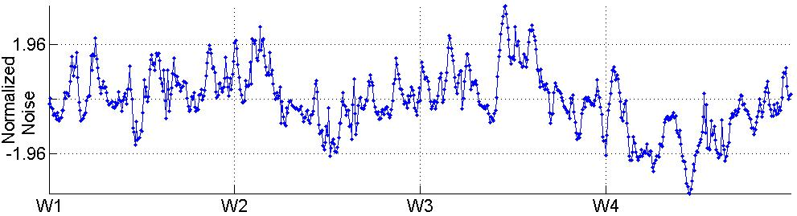
Notes:
These data points are flagged as anomalous. But they are not visually apparent in the original SRT time series.

Slide 26
Comparison with approaches that do not account for systemic variations
 | WoW | One Gaussian model of SRT | Change point detection
False negative | 10% | 35% | 40%
False positive | 7% | 17% | 19%
Notes:
The simple Gaussian model approach only detects globally huge spikes, which can overlap with the systemic
variations. The change point approach detects only local spikes between any two change points. The WoW approach can detect not only globally huge spikes, but also anomalies that are not visually apparent due to interference from systemic variations.

Slide 27
False negatives
Ticket database maintained by the search provider
Anomalies in this database:
visual inspection of the data
user complaints
flagged by an existing tool and later verified manually
Notes:
To conclude our study,
In conclusion,
Our work was motivated by the wide variation in SRT as seen by the provider, despite being averaged over large time windows and many users, varies widely. This variation can also be counter-intuitive. As we show, SRT is in fact higher during off-peak hours, even though the load at those times is lower.
By applying an ANOVA-based method, we were able to understand the primary factors behind systemic variations in SRT. We found that systemic changes in aggregate network, query, and browser characteristics led to systemic changes in SRT. We also found that, in contrast, server response time is a smaller contributor to SRT variation.
Finally, we found that anomalies in SRT are hard to detect because they get masked by systemic changes. We developed a time-series decomposition-based method that identifies SRT anomalies by factoring out the impact of systemic variation.
----------------
First, we discuss the challenges in understanding SRT variation. It varies widely, and it is higher while traffic load is much lower during off-peak hours.
Second, To understand systemic variation, we apply ANOVA on all the time intervals we collected. The results show that to provide consistent web service latency, focusing on server processing time alone is insufficient. Instead, network, query type, and browsers have become the primary factors. There are higher fractions of slower networks, richer queries, and faster browsers during off-peak hours. To improve the SRT during off-peak hours, search providers can customize the design to slower networks, richer queries, and account for the strength and weakness of browsers.
Lastly, our study also emphasizes the importance of factoring out systemic variation in anomaly detection.
--------------

Slide 28
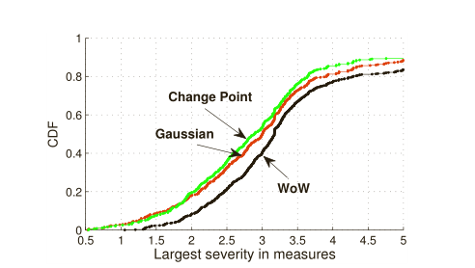
False positive
Compute the largest severity value across all measures
Consider an SRT anomaly to be a false positive, if the largest severity value does not indicate an anomaly, that is, it is under 1.96

Slide 29
Diagnosing Anomalies
Divide the measures into three classes:
Network(Tnet and Tfs )
Server (Tfc , Tsc , Ttc )
Client (TresHTML ,Tbrand , TBoP , Thead , Tref , and T script )
Notes:
To conclude our study,
In conclusion,
Our work was motivated by the wide variation in SRT as seen by the provider, despite being averaged over large time windows and many users, varies widely. This variation can also be counter-intuitive. As we show, SRT is in fact higher during off-peak hours, even though the load at those times is lower.
By applying an ANOVA-based method, we were able to understand the primary factors behind systemic variations in SRT. We found that systemic changes in aggregate network, query, and browser characteristics led to systemic changes in SRT. We also found that, in contrast, server response time is a smaller contributor to SRT variation.
Finally, we found that anomalies in SRT are hard to detect because they get masked by systemic changes. We developed a time-series decomposition-based method that identifies SRT anomalies by factoring out the impact of systemic variation.
----------------
First, we discuss the challenges in understanding SRT variation. It varies widely, and it is higher while traffic load is much lower during off-peak hours.
Second, To understand systemic variation, we apply ANOVA on all the time intervals we collected. The results show that to provide consistent web service latency, focusing on server processing time alone is insufficient. Instead, network, query type, and browsers have become the primary factors. There are higher fractions of slower networks, richer queries, and faster browsers during off-peak hours. To improve the SRT during off-peak hours, search providers can customize the design to slower networks, richer queries, and account for the strength and weakness of browsers.
Lastly, our study also emphasizes the importance of factoring out systemic variation in anomaly detection.
--------------

Slide 30
Diagnosing Anomalies
Only one class of measures is anomalous, then we deem the problem likely lies in the corresponding class
Only one class is anomalous when SRT is anomalous frequently
Notes:
To conclude our study,
In conclusion,
Our work was motivated by the wide variation in SRT as seen by the provider, despite being averaged over large time windows and many users, varies widely. This variation can also be counter-intuitive. As we show, SRT is in fact higher during off-peak hours, even though the load at those times is lower.
By applying an ANOVA-based method, we were able to understand the primary factors behind systemic variations in SRT. We found that systemic changes in aggregate network, query, and browser characteristics led to systemic changes in SRT. We also found that, in contrast, server response time is a smaller contributor to SRT variation.
Finally, we found that anomalies in SRT are hard to detect because they get masked by systemic changes. We developed a time-series decomposition-based method that identifies SRT anomalies by factoring out the impact of systemic variation.
----------------
First, we discuss the challenges in understanding SRT variation. It varies widely, and it is higher while traffic load is much lower during off-peak hours.
Second, To understand systemic variation, we apply ANOVA on all the time intervals we collected. The results show that to provide consistent web service latency, focusing on server processing time alone is insufficient. Instead, network, query type, and browsers have become the primary factors. There are higher fractions of slower networks, richer queries, and faster browsers during off-peak hours. To improve the SRT during off-peak hours, search providers can customize the design to slower networks, richer queries, and account for the strength and weakness of browsers.
Lastly, our study also emphasizes the importance of factoring out systemic variation in anomaly detection.
--------------

Slide 31
Diagnosing Anomalies
More than one class are anomalous decision logic:
First, if any Server measures are anomalous, we deem that the anomaly is in the data center
Second, if Tnet is anomalous, but not any Server measure, then we consider it as an anomaly associated with the network
Finally, we consider that the remaining cases are due to client behaviors
Notes:
To conclude our study,
In conclusion,
Our work was motivated by the wide variation in SRT as seen by the provider, despite being averaged over large time windows and many users, varies widely. This variation can also be counter-intuitive. As we show, SRT is in fact higher during off-peak hours, even though the load at those times is lower.
By applying an ANOVA-based method, we were able to understand the primary factors behind systemic variations in SRT. We found that systemic changes in aggregate network, query, and browser characteristics led to systemic changes in SRT. We also found that, in contrast, server response time is a smaller contributor to SRT variation.
Finally, we found that anomalies in SRT are hard to detect because they get masked by systemic changes. We developed a time-series decomposition-based method that identifies SRT anomalies by factoring out the impact of systemic variation.
----------------
First, we discuss the challenges in understanding SRT variation. It varies widely, and it is higher while traffic load is much lower during off-peak hours.
Second, To understand systemic variation, we apply ANOVA on all the time intervals we collected. The results show that to provide consistent web service latency, focusing on server processing time alone is insufficient. Instead, network, query type, and browsers have become the primary factors. There are higher fractions of slower networks, richer queries, and faster browsers during off-peak hours. To improve the SRT during off-peak hours, search providers can customize the design to slower networks, richer queries, and account for the strength and weakness of browsers.
Lastly, our study also emphasizes the importance of factoring out systemic variation in anomaly detection.
--------------

Slide 32
Conclusions
Understanding SRT is challenging
Changes in user demographics lead to systemic variations in SRT
Debugging SRT is challenging
Must factor out systemic variations
Notes:
To conclude our study,
In conclusion,
Our work was motivated by the wide variation in SRT as seen by the provider, despite being averaged over large time windows and many users, varies widely. This variation can also be counter-intuitive. As we show, SRT is in fact higher during off-peak hours, even though the load at those times is lower.
By applying an ANOVA-based method, we were able to understand the primary factors behind systemic variations in SRT. We found that systemic changes in aggregate network, query, and browser characteristics led to systemic changes in SRT. We also found that, in contrast, server response time is a smaller contributor to SRT variation.
Finally, we found that anomalies in SRT are hard to detect because they get masked by systemic changes. We developed a time-series decomposition-based method that identifies SRT anomalies by factoring out the impact of systemic variation.
----------------
First, we discuss the challenges in understanding SRT variation. It varies widely, and it is higher while traffic load is much lower during off-peak hours.
Second, To understand systemic variation, we apply ANOVA on all the time intervals we collected. The results show that to provide consistent web service latency, focusing on server processing time alone is insufficient. Instead, network, query type, and browsers have become the primary factors. There are higher fractions of slower networks, richer queries, and faster browsers during off-peak hours. To improve the SRT during off-peak hours, search providers can customize the design to slower networks, richer queries, and account for the strength and weakness of browsers.
Lastly, our study also emphasizes the importance of factoring out systemic variation in anomaly detection.
--------------

Slide 33
Questions?

